Slide 1


Introduction to Git & GitHub
Name : Wasit Shafi
Roll no : 18MCA054
Course : MCA II Sem
University : Jamia Millia Islamia

Slide 2
Outline
Introduction to VCS
Introduction to Git
Introduction to GitHub
Git v\s GitHub
Centralized v\s Distributed Model
Local 3 areas
Git Architecture
Benefits of GIT
Getting started
Basics commands
Learning outcomes

Slide 3

VCS(Version Control System)
Version control system keeps track of every modification to the code in a special kind of database & help a software team manage changes to source code over time.
Version control is all about managing multiple versions of documents, programs, web sites, etc.
Allows us to track changes in a project.
Some version control systems are- GIT, CVS(centralized version control) Mercurial, Subversion(SVN)

Slide 4
What is Git ?
Git was created by Linus Torvalds in 2005.
Git is a distributed version-control system.
Git is free and open-source software.
It is primary designed for coordinating work among programmers.
Git and Github both are different!
It is not same as cloud storage like google drive, one drive etc.
Git is installed locally on pc.

Slide 5
What is GitHub ?
GitHub is a hosting service for Git repositories i.e. it makes them accessible via the World Wide Web.
GitHub is a web-based Git repository hosting service.
Github provides a web-based graphical interface.
It provides as way to Share your repositories with others.
Users have Access to all public repositories.
We can use GIT without Github.
Github is both free and also a paid version.

Slide 6
Git V/S GitHub
Git |  | GitHub
1 | It is installed locally | Hosted in the cloud service.
3 | Maintained by the Linux Foundation. | Maintained by Microsoft.
4 | Command line based | GUI based through web
5 | Provides a desktop interface named Git GUI | Provides a desktop interface name GitHub Desktop
6 | Competes with CVS Mercurial, SVN, ClearCase etc. | Competes with Bitbucket, Gitlab etc
7 | Open Source | Include free as well as paid version

Slide 7
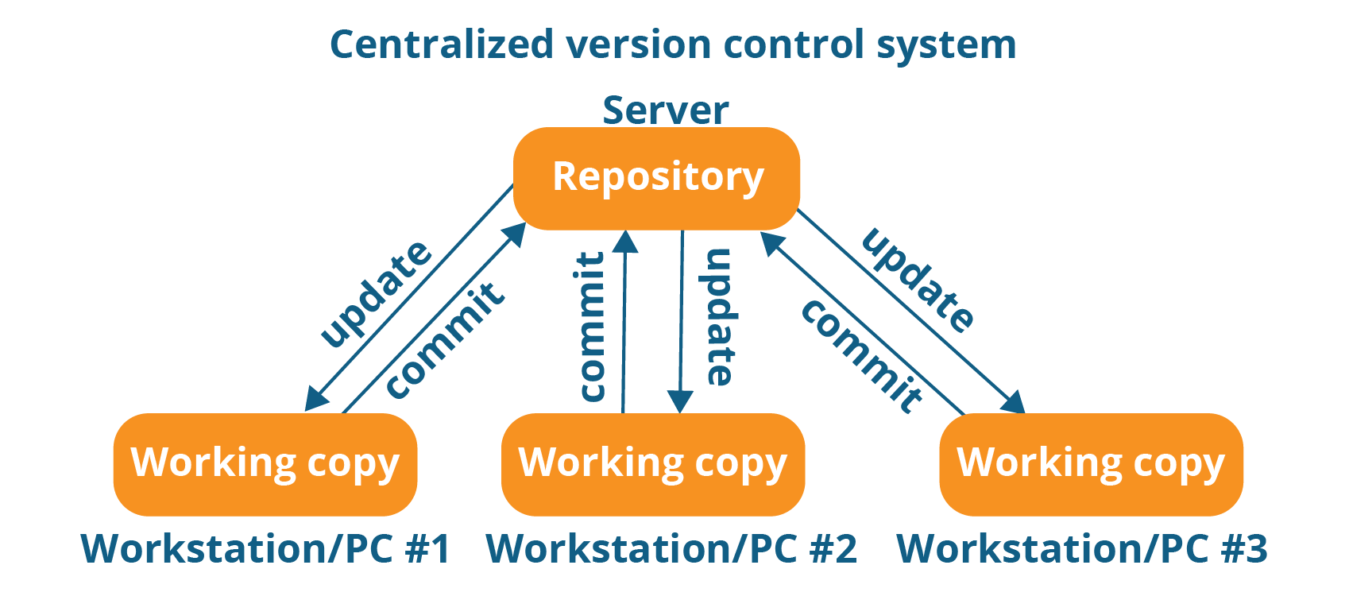
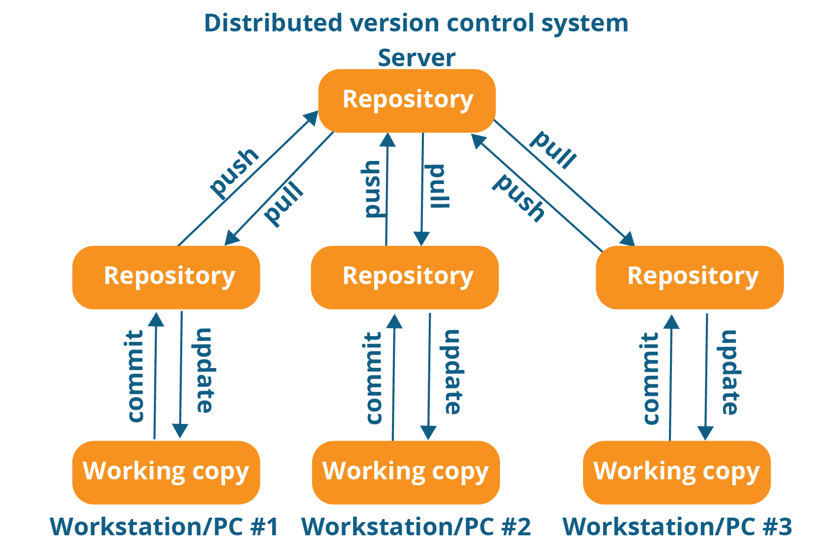
Centralized vs Distributed
Centralized version control system (CVCS) uses a central server to store all files and enables team collaboration. It works on a single repository to which users can directly access a central server.
ex: CVS, Subversion, Perforce
In Distributed VCS, every contributor has a local copy or “clone” of the main repository i.e. everyone maintains a local repository of their own which contains all the files and metadata present in the main repository. ex : Git, Mercurial, Bitbucket

Slide 8
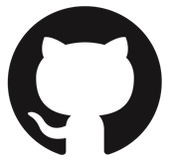
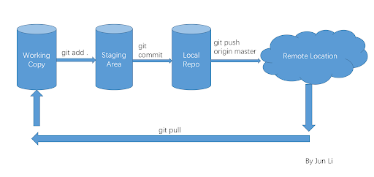



Local Git project has three areas
Local
Remote

Slide 9
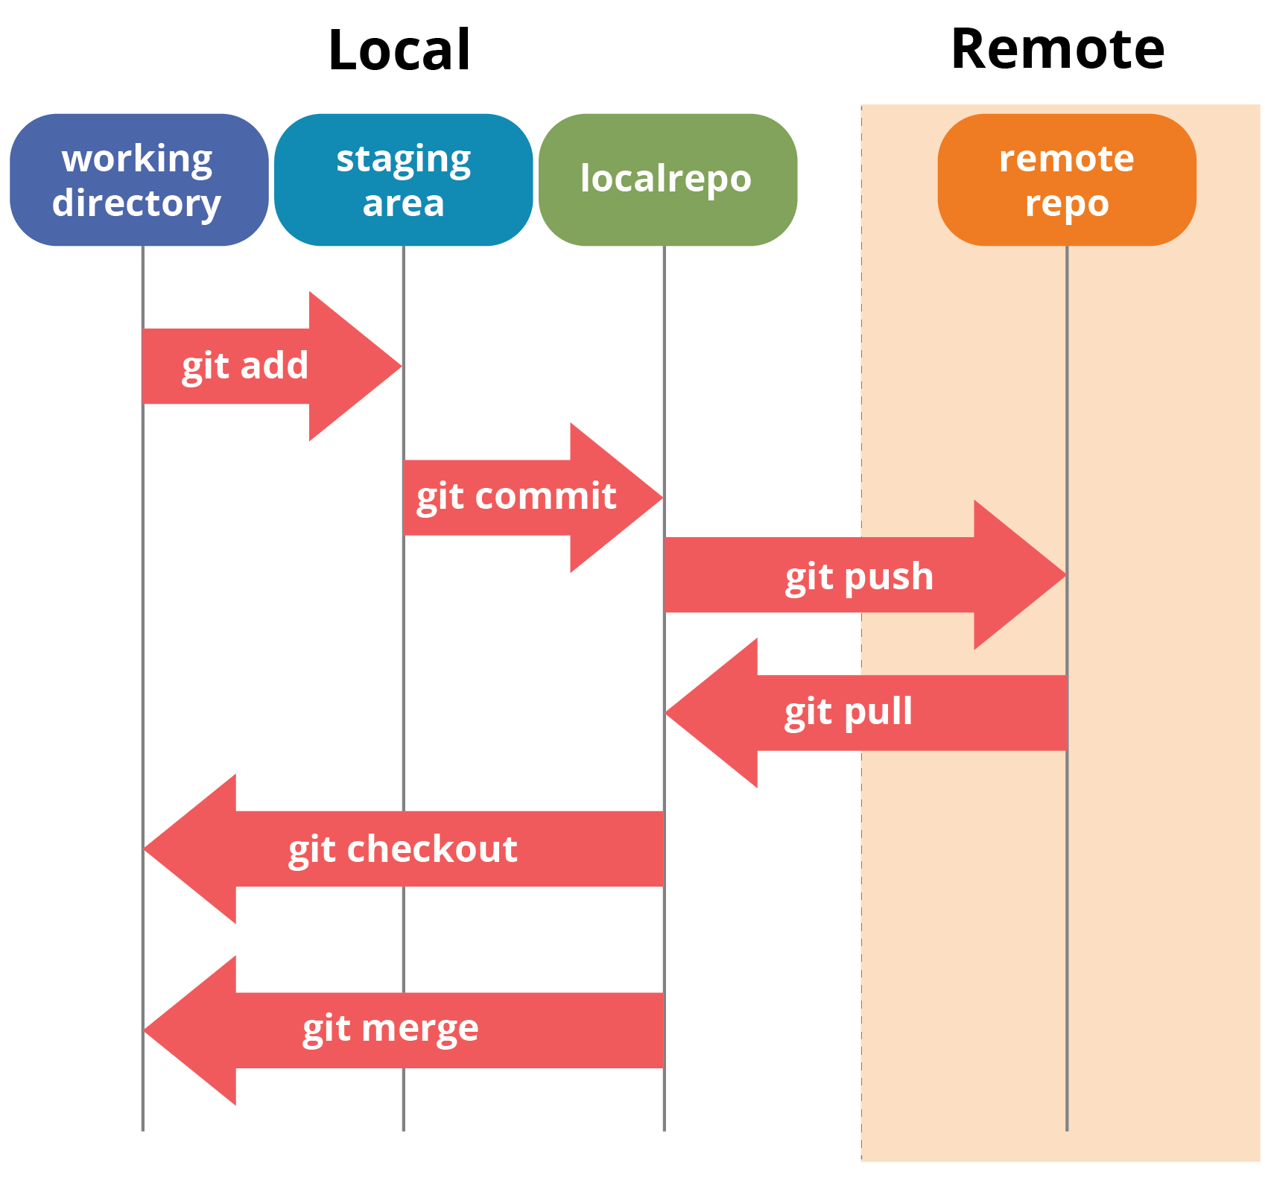
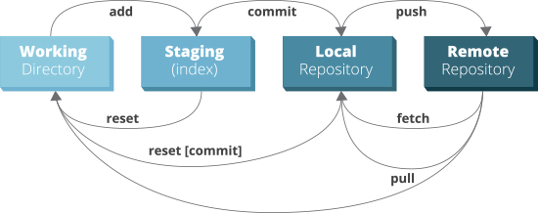
Architecture of Git

Slide 10
Benefits of using git
More efficient, better workflow, etc.
Easy to distribute work ex: clone
Easy to modify work of others ex: fork
Easy to take help from others ex: pull
Easy to Rollback a mistake eg :reset
Easy to create different version of project eg :tags

Slide 11
Getting Started
These will be set globally for all Git projects you work with.
Installing Git
Create your identity
Check your Git Settings
sudo apt-get install git
git config --global user.name “USERNAME"
git config --global user.email “USER E-MAIL”
git config --list

Slide 12
Getting Started
Colorization
Cloning a Git repository
git config –-gloabal color.ui true
git clone https://github.com/username/repo.git
Github URL
https://github.com/username/reponame
Hosting site Author Repository

Slide 13
Basic Git commands
Command |  | Description
1 | Git init | Initialize a new Git repository
2 | Git status | Checks status of repo.
3 | git add filename.txt | Adds file contents to the staging area
4 | git commit -m 'commit message' | Records a snapshot of the staging area
5 | git remote add <remotename> url | To add a new remote.
6 | git push <remote> <branch> | Push all changes to remote repo
7 | git log | Show all logs
8 | git help [command] | Get help info about a particular command
9 | git diff | Shows diff of what is staged and what is modified but unstaged

Slide 14
Learning outcomes
Got a more Understanding of VCS and GIT.
How to make a ppt.
Learnt some new git commands.

Slide 15
Thank You
Source : https://github.com/wasitshafi/JMI-MCA/tree/master/II-sem/SAD

